Slide 1
Email Spam Classification Project

Slide 2
Problem Statement
Spam Detector is used to detect unwanted, malicious and virus infected texts and helps to separate them from the no spam texts. It uses a binary type of classification containing the labels such as ‘ham’ (no spam) and spam. Application of this can be seen in Google Mail (GMAIL) where it segregates the spam emails in order to prevent them from getting into the user’s inbox.
It is a NLP problem and we are using naïve bayes classifier for this segregation.

Slide 3
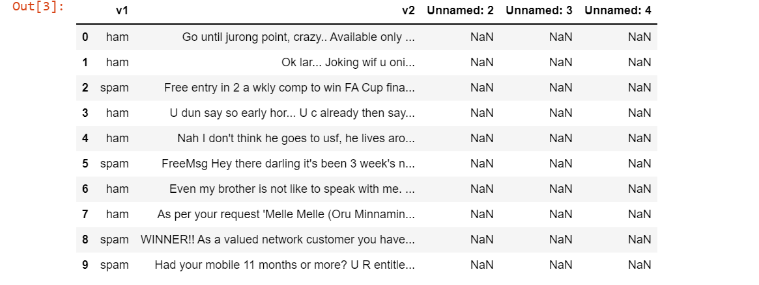
Data source and there formats
The dataset contain one message per line. Each line is composed by two columns: v1 contains the label (ham or spam) and v2 contains the raw text.This corpus has been collected from free or free for research sources at the Internet.

Slide 4
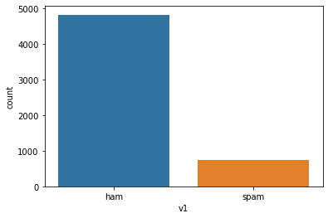
Data Pre-processing
The dataset had no null values
The dataset had 3 unnamed column with NaN values so we just dropped them.
We plotted a count plot for checking the number of spam and ham mails

Slide 5
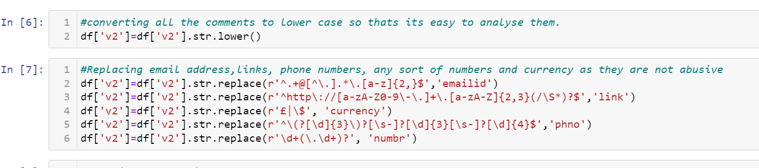
Further we replaced label column values spam and ham with 1 and 0 respectively.
Feature Engineering-We have to fetch spam or fraud words from column v2 so in order to do that we first converted entire
column v2 feature to lower case then replaced all the phone numbers, email ids, URL’s, any sort of number and currency
by phno,emailed,link,numbr and currency respectively.

Slide 6
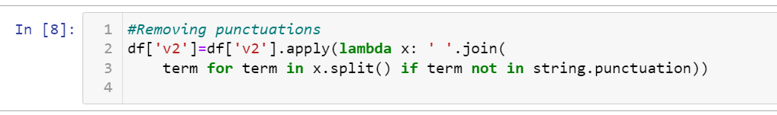
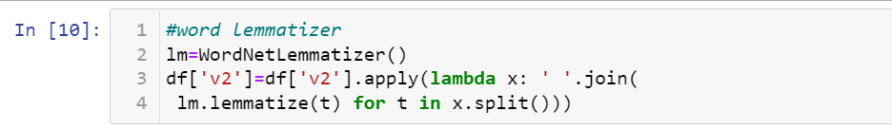
Further we removed all kinds of punctuations from the feature v2.
In order to fetch just the fraud words we also have to remove all kind of stop words.
In order to further analyse the text of column v2 using morphological analysis of the words called lemmatization.

Slide 7
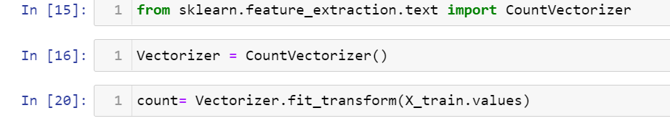
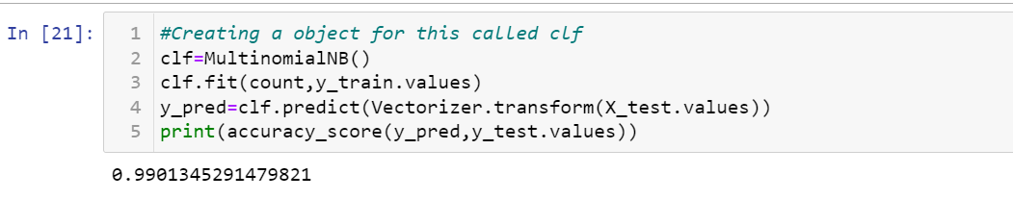
We split the data into training set and testing set using train test split method.
We further found the number of occurrences of each word using count vectorizer.
Then we applied naïve bayes classifier on the number of occurrences of each word and the feature v1 values.
This classifier gave an accuracy of 99%.

Slide 8
Hardware and Software Requirements and Tools Used
We imported following packages:
from nltk.stem import WordNetLemmatizer
import nltk
from nltk.corpus import stopwords
import string
from sklearn.naive_bayes import MultinomialNB
from sklearn.metrics import accuracy_score
import pandas as pd
import numpy as np
import matplotlib.pyplot as plt
import seaborn as sns
from sklearn.model_selection import train_test_split
from sklearn import metrics
from sklearn.metrics import roc_curve,auc,classification_report,confusion_matrix
from sklearn.feature_extraction.text import TfidfVectorizer
import warnings
warnings.filterwarnings('ignore')

Slide 9
Run and Evaluate selected models

Slide 10
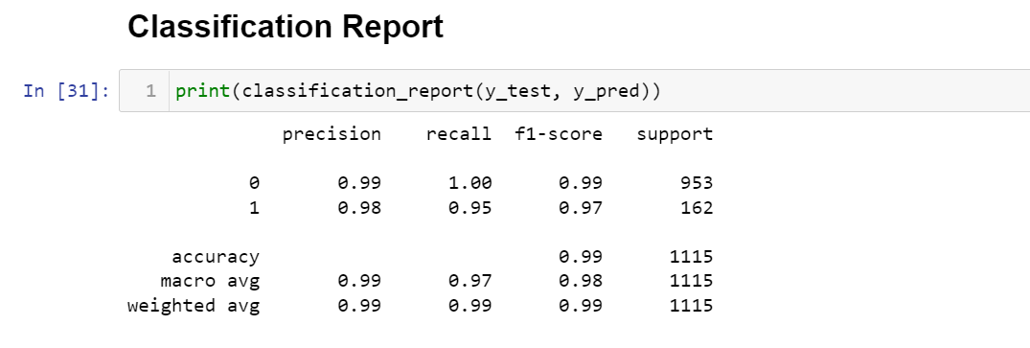
Naïve Bayes Classifier
We applied this algorithm and found the test accuracy as 99%.
We also tested this model on other metrics-
classification report:

Slide 11
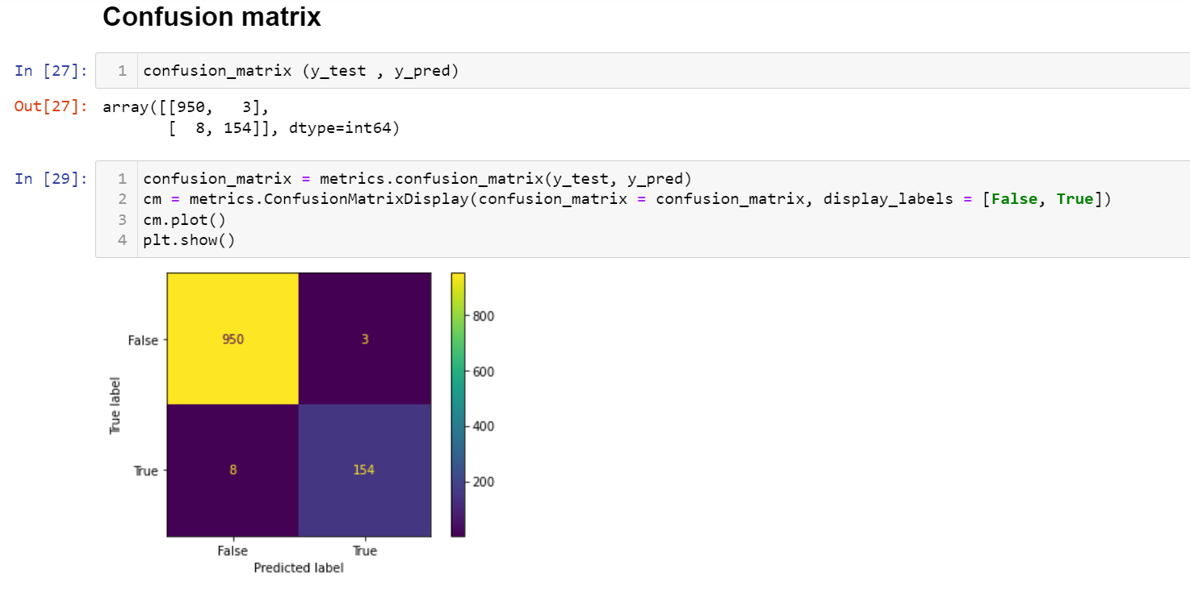
confusion matrix:

Slide 12
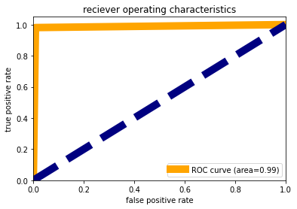
AUC-ROC Curve:

